Slide 1
Developing cross-platform mobile applications with PhoneGap
@ColinEberhardt
Notes:
SETUP:
PhoneGapStarter app loaded into VS4WP7
Emulator started, accelerometer simulator started
FireFox started, pointing to TwitterSearch index page, property finder iOS on other tab
VS4Web started with index.html, app.js, twitterSearchViewModel.js, applicationViewModel.js, wp7.css loaded

Slide 2
Overview
Why cross-platform?
Introduction to PhoneGap
PhoneGap APIs, History of PhoneGap WP7
A simple PhoneGap application
How PhoneGap works
A more complex application
KnockoutJS – MVVM, Property Finder
iOS ‘view’
Is PhoneGap a viable approach?
Notes:
Why cross-platform? – market share
Introduction to PhoneGap – basic architecture, history of WP7 version (Matt Lacey), current status, Nitobi / Apache / Callback Cordova
Developing simple page-based applications – hello world, page navigation, tombstoning, pinch zoom, back-stack
jQuery-Mobile
Developing complex applications – structuring our JavaScript, MVVM, Property Finder – how cross platform is this solution?
Knockout-JS
Back-stack handling
Conclusions
Is this a viable approach? – IE9 issues, gray rectangle, MonoTouch / MonoDroid

Slide 3
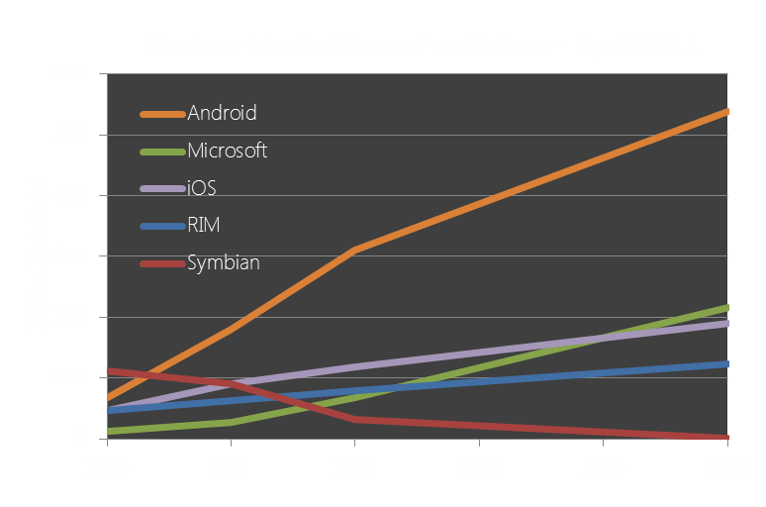
Why cross platform?
http://bit.ly/gartner-wp7-share

Slide 4




Rewrite for each platform

Slide 5

What is PhoneGap?
Phone APIs
HTML / JavaScript
Application
Phone APIs
Notes:
HTML5 / JavaScript application
PhoneGap provides:
+ A packaging mechanism
+ APIs for features that are outside of the scope of HTML5

Slide 6
PhoneGap APIs
Accelerometer
Compass
Camera
Capture
Connection
Contacts
Device
Events
File
Geolocation
Media
Notification
Storage

Slide 7
PhoneGap for Windows Phone 7
PhoneGap, first stable release, Feb 2009
Matt Lacey, August 2010, initial implementation
PhoneGap for WP7 beta, September 2011
Mango roll-out, October 2011
Adobe acquires PhoneGap, October 2011
Property Finder enters Marketplace, November 2011
http://bit.ly/property-finder
WP7 fully supported, January 2012
Notes:
Timeline me!

Slide 8
Our first PhoneGap app
PhoneGap application template
Overview of the various files
‘www’ folder - HTML / JS / image assets
GapSourceDictionary.xml
Regular WP7 Silverlight files
Simple modification
Read accelerometer data
Notes:
Anatomy of a basic application
Launch it
describe it …
‘www’ folder – HTML5 assets
GapSourceDictionary.xaml – files to load into local storage (required because you cannot read XAP content)
ManifestProcessor.js – generates the above
App, MainPage, icons …
Make changes to read accelerometer
Add JavaScript
Add HTML
Discuss how the JavaScript API works.

Slide 9
How does it work?
PhoneGap JavaScript
PhoneGap C# code
Accelerometer
acc.getCurrentPosition()
window.external.Notify()
getAcceleration()
DispatchResult()
ScriptNotify()
Notes:
NOTE: This is quite specific to the WP7 implementation of PhoneGap

Slide 10
Applications styles
Multi-page applications
Separate HTML pages
JavaScript re-loaded between each page
No state transferred from page-to-page
Back-button handling required
http://bit.ly/wp7-multipage-phonegap
Single-page applications
Page updates as application state changes
‘think’ GMail

Slide 11

Twitter Search
http://knockoutjs.com/
Notes:
Execute application
Walkthrough
Show folder structure – mirrors Silverlight application
Knockout-JS view model
Show how to run within FireFox
Back-button handling

Slide 12
Native look and feel
CSS Styling
Does not support pressed state
Disable pinch / tap zoom
Requires some ‘hacking’
http://bit.ly/suppress-pinch
Gray highlight
You’re stuck with it!

Slide 13
The WP7 IE9 browser
Pros
Much better than the pre-mango!
http://bit.ly/ie9-mobile-features
Canvas, video, audio
Many CSS3 features
Cons
A lack of touch events
The ‘gray link’ issue
http://bit.ly/stackoverflow-gray-highlight

Slide 14
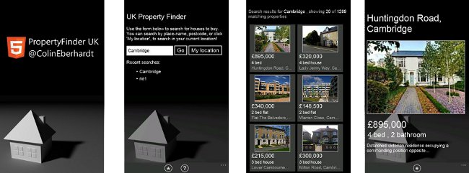
Property Finder (video)

Slide 15
Cross platform?
Knockout JS enables the use of MVVM
The ‘view’ code is currently WP7 specific
For iOS use a different view
http://jquerymobile.com/
Notes:
Just play the vid!

Slide 16

Property Finder iOS

Slide 17
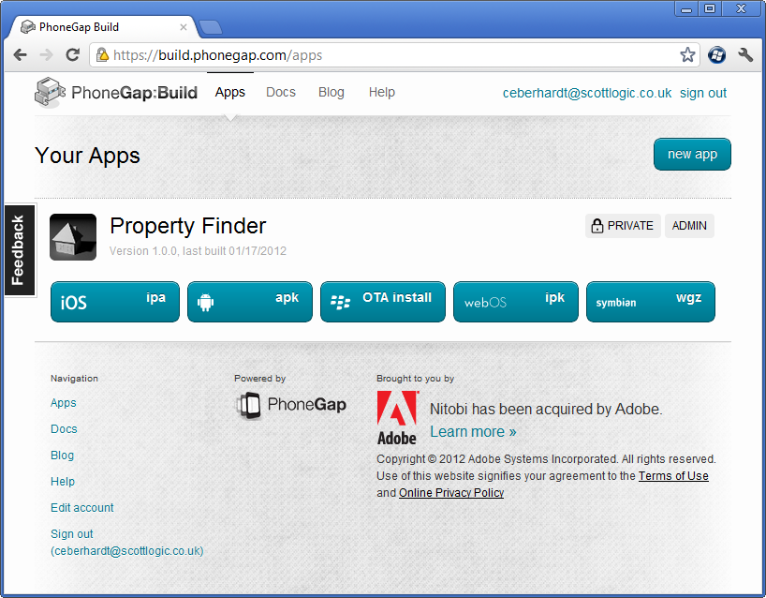
PhoneGap Build

Slide 18
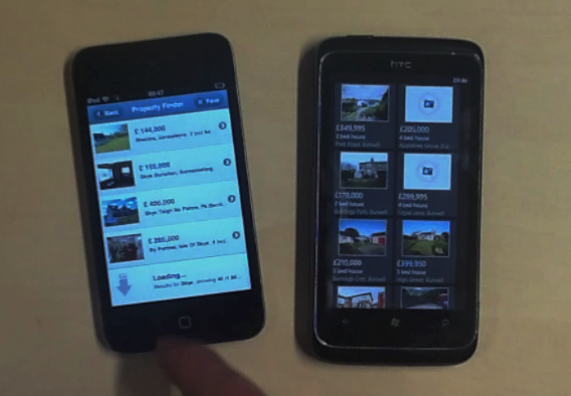
Property Finder iOS (video)
Notes:
NOTE: Horrible code required for vertical scrolling!

Slide 19
Is PhoneGap a viable approach?
Set-up cost is low
PhoneGap build removes the need for a Mac
Browser-based testing
OS specific JavaScript / CSS code
Often handled by existing JavaScript libraries
More required if you want to have a native ‘feel’
Currently most people roll-out an iOS look to Android
WP7 IE9 browser is _almost_ good enough
Webkit browsers also have major flaws – overflow:scroll

Slide 20

Is PhoneGap a viable approach?
Notes:
Create a UI that works across platforms

Slide 21
PhoneGap alternatives
MonoTouch
C# with bindings to native controls
http://xamarin.com/monotouch
Appcelerator Titanium
Previously ran JavaScript in browser, now compiles to native
http://www.appcelerator.com/
Adobe Mobile Air
AS3 running within the Air runtime
http://www.adobe.com/products/air.html

Slide 22
Image credit: Lattice by ColinBroug (http://www.sxc.hu/photo/1359433)

